Slide 1

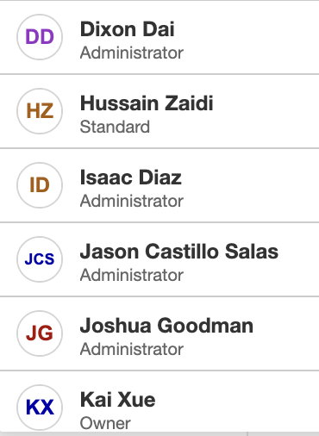

CS4800 Wildfire AI
Group Members:

Slide 2


Processing Data
Weather data: The California Irrigation Management Information System
Fire Data: Kaggle.com California WildFires (2013-2020)
We matched the dates & locations of the fire data to weather data and combined the information
Sorting in Excel, exporting as .csv
Formatted the data to feed into the training model

Slide 3


Used Jupyter notebooks in JupyterLab
Tried DeepAR as well as a foray with SageMaker Canvas
Ended up using XGBoost

Slide 4
XGBoost vs DeepAR Forecasting
XGBoost can be used for solving regression problems.
It provides a continuous value between 0 and 1 which is the prediction value that represents a probability of the target variable.
The first column is called the target variable and the other remaining columns are the feature variables that help to build the predictive model.
Since we are trying to predict whether there was a fire or not, this algorithm is appropriate for solving our problem
DeepAR is a time-series algorithm that builds a model using the output of the previous day as input.
This algorithm would also work well for our project, but the result of this algorithm was not a continuous value.

Slide 5
Creating the Lambda Function
To expose the endpoint used for making predictions, a lambda function that uses our endpoint was deployed using API Gateway.
For the lambda function, an environment variable that is the name of our endpoint first needs to be set up. Then we can call the invoke_endpoint function on our sagemaker runtime variable with the necessary data that was passed to our function through the payload.
To get the list of station IDs, which we used as our locations, we used an endpoint that was created by the web service team that queried a database that had the location data. Then we run our prediction for every location.
After we have collected all the predictions, we return that entire list as the body of the JSON return file.
Now that we finished the lambda function, we can deploy it using API Gateway which supplies us with the URL needed to invoke our function which uses our endpoint.

Slide 6
Coordinating with Web Service Team
Most of our coordination involved discussing how the data is passed between modules, what data needs to be calculated using historical data, and how some data should be formatted:
The name of the labels of the data in the payload that is passed to our lambda function needed to be known in advance. We settled on ‘air’, ‘hum’, ‘date’, ‘p30’, ‘p60’ and ‘p90’.
The temperature, humidity, and precipitation needed to calculated using historical data; we gave our historical data to the web service team that stores it in a database which is queried when it is needed.
Dates need to be converted into a unique value, and we settled on converting the date into an integer. The date format of mm/dd/yyyy is converted into an integer in the form yyyymmdd. For example, 01/01/2013 is converted into 20130101.

Slide 7
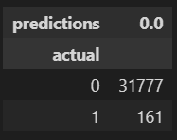
Test Cases
Unit Tests:
Before training the AI model, we get a subset of the training data to see how well our model can predict wildfires. Unfortunately, the result is not as we had hoped. Of all of the testing data we had, we predicted that there would not be any fires, but there were 161 fires in the test data:
Integration Tests:
Once our endpoint was created and we had a URL that we could pass a payload to, we worked closely with the webservice team to make sure that they can access our endpoint. We used the Postman application to test whether our endpoint can be accessed through other users.

Slide 8
Test Cases
Validation Testing:
We needed to test whether our endpoint can wait for a request, and then respond back with predictions when it did receive a request. This was also done using Postman.
System Testing:
Now that our endpoint was connected to the web service team and predictions can be delivered to them on request, the web service team can pass the predictions to the web app team which displays the results on a map. To test this, we simply used the web app teams application to pass it data and wait for the map to be updated with the resulting predictions.

